Slide 1
HOW TO HEAL
HEALING BASICS
By: Berry Bellbell (AKA RatGirl)

Slide 2
CONTENTS OF THIS PRESENTATION
Gear Sets | Commonly used gear sets and combos
Traits and Enchants | Traits and Enchants and why certain combos matter
Champion Points | Blue and Red CP
Buffs and Debuffs | What buffs are important and how to apply them
Applying Status Effects | Where do status effects come from and why are they important
Basic Bar Setups | Base Bar setups so you don't have to relearn across different subclassing
Subclassing | Common Subclasses and the skills they use
General Rotations | How do healer rotations work?
Common Addons | Addons to use in content and what they do
Misconceived skills | How do the skills target? How many people do they hit?
Reading Logs for Healing | What do you look at in logs to judge your progress? (HINT: NOT OVERHEALS)

Slide 3
TYPES OF GEAR
03
DEBUFF SETS
SLAYER SETS
01
MONSTER SETS
04
02
BUFF SETS
OTHER SETS
05
KEY:
- Not used often
Active cast
Ultimate cast
Passive
(MK) Martial Knowledge
(Zen)Zen’s Redress
(RO)Roaring Opportunist
(MA) Master Architect
(WM) War Machine
(OZ) Ozezan
(Symp/SoB) Symphony of Blades
(TB)The Blind
(Naz) Nazaray
(AD) Archdruid
(TK) Troll King
(PP) Pillager’s Profit
(SPC) Spell Power Cure
(JO)Jorvulds
(PA) Powerful Assault
(CP)Combat Physician
(SAX)Saxhleel Champion
(Xoryn) Xoryn’s Masterpiece
(Arkasis) Arkasis’s Genius
Trainee (Chest)
(Pearls) Pearls of Ehlnofey
Master’s Resto
Black Rose Prison Resto
Spaulder

Slide 4
GEAR COMBINATIONS
Usually Healer gear is split into
Slayer+Buff+Monster+Other(s)
Buff(Ulti)+Buff(Active)+Monster+Other(s)
A general setup includes:
Monster Set
Trainee chest
3 piece armor+resto (active set-unless medium)
1 piece armor+backbar weapon+jewelry (ulti proc set)
OR
Monster Set
5 piece armor (passive set)
Jewelry+Backbar weapon (active set)
Front Bar Arena Staff
EXAMPLES:
RO/JO/OZ/Masters resto
  Body JO
  Destro and jewels RO
SPC/PP/Symp/Trainee/Pearls
  Chest Trainee
  3 piece armor+resto SPC
  1 piece armor+ rings+backbar PP
MA/PA/AD/Trainee/Pearls
  Chest Trainee
  3 piece armor MA+Destro or resto
  Pants+ rings+resto or backbar PA
KEY:
Active cast
Ultimate cast
Passive

Slide 5
Gear Weights
Light | Medium | Heavy
Per Piece: 1% Reduce Damage from magical attacks 3% Reduce Cost of roll dodge 5% Reduce cost of Break Free 3% Reduce cost of Sprint 4% Mag Recov 2% Mag Cost reduction 726 Spell Resistance | Per Piece: 2% Reduce Aoe damage after roll dodge 3% Reduce Cost of Block 4 % Reduce Cost of Roll dodge 2% Critical Healing 4% Stam Recov 2% Stam Cost Reduction 2% weapon and spell damage | Per Piece: 2% Reduce damage from martial attacks 1% block mitigation 343 Physical and spell resistance 108 mag and stam restore when damage taken 2% max health 4% recovery of resources w/ heavy
Other Passives: Undaunted: 2% max mag, stam, health per type of armor equipped
common setups:5/1/1, 6/1/0, 7/0/0

Slide 6
TRAIT & ENCHANTS
ARMOR | JEWELS | RESTO | DESTRO/DAGGERS
TRAITS
Divines Reinforced (sometimes) | Infused Swift Bloodthirsty Arcane | Decisive Powered Infused | Infused Charged Nirnhoned (sometimes)
ENCHANTS
Max Mag Max Health (sometimes) | 1 or 3 infused reduce potion cost Reduce spell cost Mag Recovery Spell damage (sometimes) | Berserker Absorb Mag Weakening if not backbar | Weakening Crusher(MUST BE INFUSED) (daggers-Poison/fire)

Slide 7
WHY 1 OR 3 Reduced Infused Potion cost? (or none)
Trait/Enchant | Potion Cooldown | Potion Ultigen | %Difference Ultigen [from none] | Direct +Mag Change from Potion
No Reduce Potion | 45(s) | 0.49 (ulti/s) | N/A | +168 (mag/s)
1 Reduce Potion (RP) | 40 | 0.55 | 12.5% | 190
1 Infused RP (iRP) | 37 | 0.59 | 21.6% | 205
2 RP | 35 | 0.63 | 28.6% | 217
1RP, 1iRP | 32 | 0.69 | 40.6% | 237
3RP | 30 | 0.73 | 50.0% | 253
2iRP | 29 | 0.76 | 55.2% | 261
2RP, 1iRP | 27 | 0.81 | 66.7% | 281
1RP, 2iRP | 24 | 0.92 | 87.5% | 316
3iRP | 21 | 1.05 | 114.3% | 361
Relative mag change per infused reduce spell cost:
324.8 mag/skill -(% cost reduction from armor)
Relative mag change per infused mag recovery:
135.2 mag/s

Slide 8
Champion Points/ Mundus
Red CP (more personalized)
Slot 1- Boundless Vitality
Slot 2- flex spot
  Expert Evasion
  Slippery
  Rejuvenation
  Celerity
Slot 3/4- flex spot
  Rejuvenation
  Shield Master
  Bastion
  Fortified
  Pain’s refuge
  etc
Blue CP
Slot 1- must have one on each healer
  (Enliv) Enlivening Overflow
  (FtB) From the Brink
Slot 2- flex spot
  Rejuvenator
  Fighting finesse
  Ftb or Enliv if solo healing
  Focused mending- ss tombs(maybe)
Slot 3- Swift Renewal
Slot 4- Soothing Tide
MUNDUS:
Does not really matter
Adjust to your build/ regen
Usually: ritual/atro
HEALERS SHOULD NOT BE SLOTTING SPIRIT MASTERY-THANKS

Slide 9
Buffs & Debuffs!
Debuffs
What are they?
Buffs:
What are they?
a negative effect applied to the enemy that provides a specific benefit to the group
Not to be confused with status effects
Important Debuffs for healers:
Off balance
Crusher
Weakness
Other Considerations
Minor Brittle
Minor Cowardice
Major/ Minor Breach
Minor Mangle
Zen
etc
A positive effect applied to yourself or an ally
Important Buffs for Healers:
Major Slayer
Major Courage
Minor Resolve
Minor Intellect/Endurance
Minor Berserk
Minor Toughness
Major Force
Other Considerations
Major/Minor Mending
Major/Minor Vitality
Martial Knowledge
Berserker
Enlivening
Major/Minor Heroism
etc
For What Buffs and Debuffs do: ESO Buffs and Debuffs

Slide 10








Applying Status Effects
Burning
Chilled
Concussion
Disease
Hemorrhaging
Overcharged
Poisoned
Sundered
Enchants:20% | St DPS: 10%
AoE DPS 5% | St DoT: 3%| Aoe DoT: 1 %
Website for status effects: Status Effect Database
Applied by Fire
Target Burns for additional 4s
Applied by Frost
Instant Damage
Minor Maim 4s
Minor Brittle 4s (Ice Staff on active bar)
Applied by Shock
Instant Damage
Minor vulnerability 4s
Applied by Disease
Instant aoe damage
Minor defile 4s
Applied by Bleed
Bleeds 4s
Stacks up to 3x
Increase damage of bleed per stack 25%
Applied by Magic
Restore 65 mag
Minor Magickasteal 4s
Applied by Poison
Poison damage 4s (execute dmg)
100% bonus to targets under 100% health
Applied by Physical
Instant damage
Grants 100 weapon and spell damage 4s

Slide 11
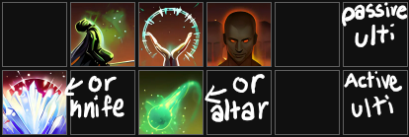
Basic Bars
If more space needed first to remove is radiating
healing burst can be used instead of combat prayer if minor resolve and minor berserk sourced elsewhere
Front: Resto staff
Flex | Illustrious | radiating | combat prayer | Flex | Passive Ulti
Backbar: Destro Staff or Dual Wield
Blockade or Knife | Flex | Orb or Altar | Flex | Flex | Active Ulti
PLEASE NOTE POSITIONS 1-5 ON BAR DON’T MATTER USE WHAT WORKS BEST FOR YOU; IF YOU HAVE ISSUES HITTING 1-5 CONSIDER PUTTING SPAMMABLE LOCATIONS ON MOUSE
Why?
Illustrious is smart target aoe heal overtime and can be used for grand rejuvenation
Combat Prayer is a heafy burst heal which provides m.Resolve and m.Berserk
Lightning Blockade or knife can provide off balance
Orb or Altar provide life saving synergies
Radiating provides a strong and sticky HoT that can be cast from long range
ESO bar builder

Slide 12






















Subclassing
Nightblade
Templar
Necromancer
Warden
Sorcerer
Arcanist
Green Balance | Restoring light | Siphoning
Flex | Necro | Siphoning
Daedric | Curative | Siphoning
Siphoning: Used for ultigen/ debuffs/healing passives
Skills used:
Restoring Light: used for endurance/synergies/ healing passives
Skills used:
All lines: used for ultigen/debuffs/healing
Skills used:
Green Balance: used for buffs/healing
Skills used:
Daedric Summoning: Used for ulti reduce cost and atro
Skills used:
Curative Runeforms: Used for shields/buffs/ healing passives
Skills used:

Slide 13
HEAL TYPES
Sticky HoT
AoE HoTs
Burst Heals
Shields
Direct Target Heal over Time that moves with your target
Area of Effect Heal over Time does not move with your target
An Instant Heal that applies on cast only
Damage Shields that negate damage taken for a certain health value
Smart Heals:
Heals that target the lowest health target or allies without buff
Random Heals:
Heals that target a first or random players in aoe and will not change throughout duration unless targeted player(s) leave(s)

Slide 14
ROTATION OVERVIEW
Healer roto is the same as a dps roto: cast buffs before important burst damage times, re-up hots before mechs happen, burst during mech, apply sticky hots before group moves, re-apply ground aoe hots before or at end of transition (burst during transition if necessary). Don’t Let Hots/Buffs drop.
Pre
Pre-HoT
Before fight start apply sticky and aoe hots
Apply Buffs/Debuffs
Apply Hots
Apply Set and Skill buffs/debuffs
1
2
Apply AoE and Sticky hots and/or shield
Burst Heal Mechs
Filler skills/Apply Hots
Use filler sticky hots and shields in between buffs/debuffs/ aoe hots
4
3
Use direct burst(instant) heals to heal tanks/dps out of mechanics

Slide 15
Common Addons for Healers
Buffs:
“Buff the Group” - buffs applied to players
“Group Buffs”- buffs applied to players
Hypertools - buff duration
BSC’s Pillager’s Profit - pillagers # of players applied+ cooldown+ ultigiven
Roaring Opportunist by:tmbrinks - Roaring opportunist duration+ cooldown by stack
Debuffs:
Debuff Me - up to 4 debuffs applied per target around cursor
Hypertools- debuffs stack/duration
Terrain Marking
Elms
Markers
Breadcrumbs - can draw lines
General:
Action Duration Reminder -skill cooldown
Wizards Wardrobe - setups saving
OdySupport Icons - player positions and debuffs
Hodors - group wide ultimate buff/debuff tracking
Crux Counter- arcanist crux tracking
Perfect Weave - aoe hot weaving
Combat Metrics - fight statistics
esologs- need app + addon
Trial:
Crutch Alerts - prominent trial alerts
Qcell’s ____ Helper - older trials specific mechs
____ Helper by:Wondernuts - newer trials specific mechs
Log Debugger/Tool- for zens and scribing
Elms Editor- for editing when not in trial

Slide 16
Common Misconceived Skills/Sets
Skill/Set:
Ultimate Ability
Ulti sets (sax/wm/pa/pp/naz)
Combat prayer
Powerful Assault
Roaring Opportunist
Radiating Regen
Zenas
SPC
Healing Springs
Illustrious
On Heal vs Overheal
Area of Target
Is not stronger at higher ultimate unless specifically stated
Effect Duration is based on total ultimate out of 500
Hits 6 players per cast
Hits 6 players per cast, smart applies to players w/o buff, random to players with buff
Hits 6 players per cast
Hits 3 players per cast
Now a random target- targets first 6 players inside and does not move from those players until they exit
NOT A PASSIVE: applies major courage for 5s on overheal. Overheal must tick while on active bar
Random target: heals tick on random decided 6 players
Smart target: heals tick on lowest health 6 players (at time of healing)
If set requires “heal” to proc the player must be healed from <100% health, if set requires “overheal” to proc then player must be at 100% health
Specifically stated: can be cone, circle, 180/360 radius,etc

Slide 17
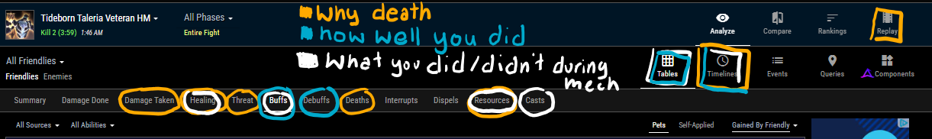
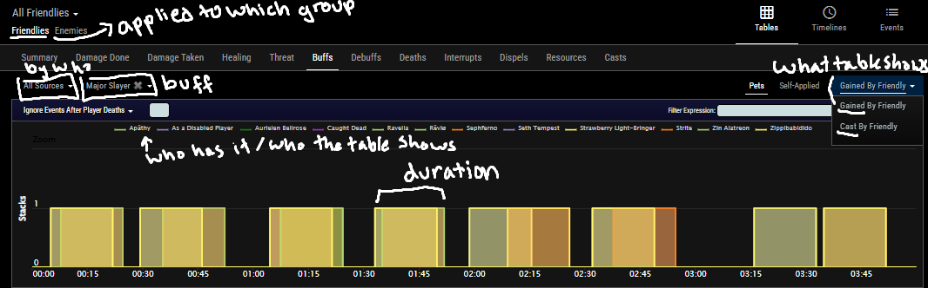
ESO LOGS- Overview
ESO LOGS- Buffs
THESE SLIDES ARE FOR REFERENCE ONLY, PRESENTATION PROCEEDS ON ESOLOGS.COM

Slide 18
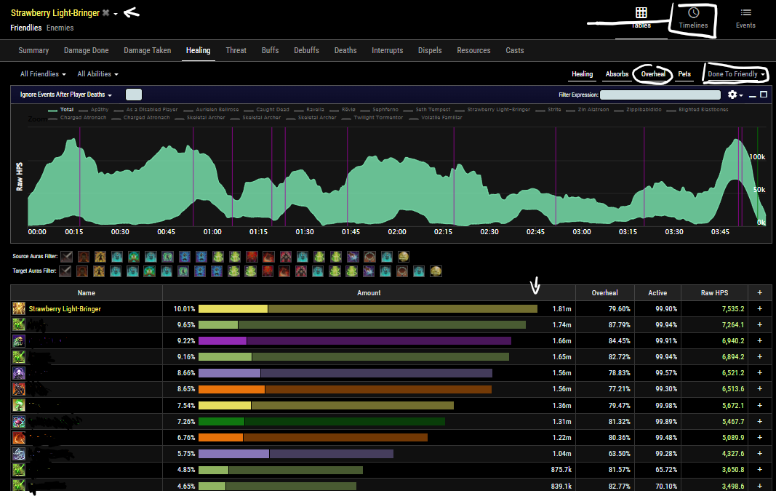
ESO LOGS- Healing
Who did it
By what during what time
Healing received (average)

Slide 19
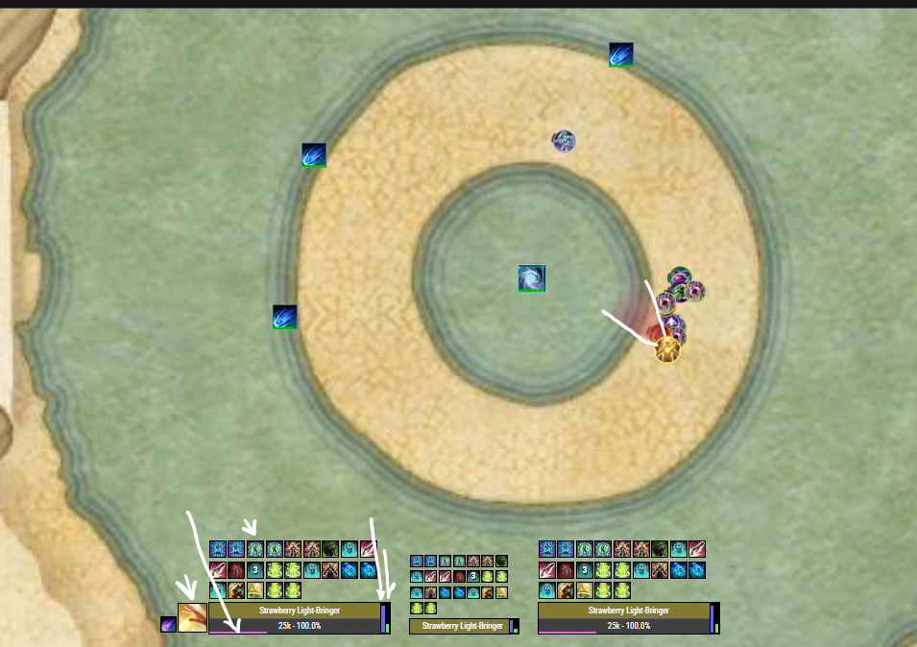
ESO LOGS- Replay Tab
Direction faced
Health
Buffs
Mag
Last cast
Stam

Slide 20

Thank You For Listening!

